Slide 1


Specialized services
Stamp Quality

Slide 2


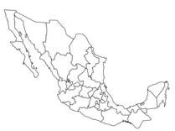
We are a headquarter that have operations in 6 locations on México.
San Luis Potosí.
Querétaro.
Guanajuato.
Nuevo León.
Coahuila
Veracruz.
Aguascalientes
Our Values
Focused on our customers.
Integrity.
Continuous Improvement.
Quality services.
Providing support to solve different issues in the industry, such as inspections, rework, suppliers developing and material supplies with certified staff.

Slide 3










Our Commitment:
Risk Mitigation
Evaluate all working methods to mitigate all potential leakage hazards.
Closer Communication
Continuous comunication with all the customers, providing feedback of all the issues or suggestions that can improve the process.
Continuous Evalutation
Standardize staff quality control, through training and follow-up to training matrix
Supervision
Daily Tracking Records
Supervisor 100% dedicated to personnel at each shift.
To ensure compliance with rates and assurance of the quality standards
Deliver reports, graphs and findings, according the customer requirements.

Slide 4





Services offered by Stamp Quality
At Stamp Quality, we offer a wide range of complementary services designed to support the operational and infrastructure needs of our clients.
Our main services include:
Housekeeping Services
Professional cleaning solutions for industrial, office, and comercial areas. We ensure a safe, hygienic, and organized environment that promotes productivity and well-being.
Civil Sector
We carry out construction, remodeling, and maintenance projects with a focus on quality and safety.
Office Supplies
Comprehensive supply of stationery and office materials to keep your administrative operations running efficiently.
Office and production area
remodeling
Drywall and panel installations
Construction and maintenance of industrial floors, including epoxy coatings and Surface treatments.

Slide 5








Private Security
Services offered by Stamp Quality
Personal Protective Equipment (PPE)
Professional security personnel and surveillance systems to protect your facilities, assets, and personnel.
Supply of certified safety equipment to ensure worker protection in compliance with current regulations.
Sale of Cleaning Supplies
Blacksmith Services
Design and manufacture of metal structures, gates, railings, and custom projects with high durability and precision.
Distribution of cleaning products and materials tailored to industrial, commercial, and office needs.
Our goal is to be a trusted partner that provides integrated solutions, helping companies maintain safe, efficient, and high-quality operations.

Slide 6




Executive Transportation Services
Services offered by Stamp Quality
We provide safe, punctual, and comfortable transportation for executive personnel, ensuring professionalism, discretion, and realiability in every transfer. A complete logistic plan is developed for each client to guarantee efficient routes, optimal scheduling, and an exceptional service experience.
Personnel Staffing Recruitment
We offer a comprehensive recruitment, selection, and evaluation service for both operational and administrative positions.
Administration and interpretation of psychometric test.
Structured and competency- based interviews.
Selection of candidates according to the client’s required profile. We ensure the recruitment of reliable, skilled candidates who align with each company´s organizational culture and job requirements.

Slide 7






Services offered by Stamp Quality
At Stamp Quality, we specialize in providing professional quality services that help our clients maintain high productions standards and ensure customer satisfaction.
Our main services include:
Inspection
Detailed visual and dimensional checks to identify nonconformities and ensure product quality.
Sorting
Classifications and separations of components according to established quality criteria.
Rework
Correction and reprocessing of parts of materials to meet customer specifications.

Slide 8
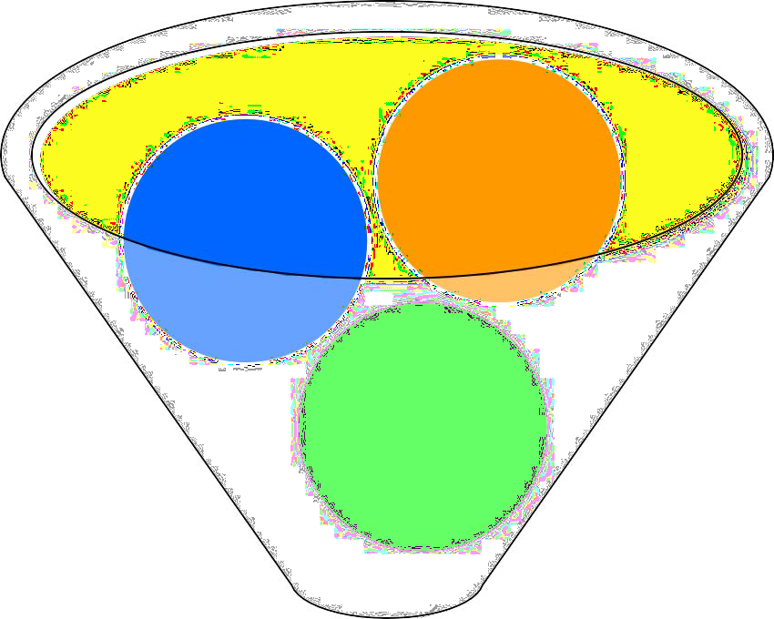
Inspection
Rate
Skill Matrix
Trainning
Supervision
LPA`s
Personal Selection
Inspection Strategy
Selection of the proper personal.
Trainning (Safety, 5’s, WI, Rate & Continuos Improvement).
Warranty the rate of the inspection (Shipping rate vs inventory).
Lead Supervision of personal.
Tracking of Skills Matrix for each operator.
Daily LPA.
Warranty the 100% inspected material
Material 100% Inspected

Slide 9

Operational Results and Continuous Improvement
In Stamp Quality, we are committed to continuous improvement and operational efficiency.
Through the implementation of standardized processes and results-driven strategies, we have archieved:
Improvement of the training system for new employees,
ensuring faster, safer, and
more effective integration into operations.
10% increase in productivity,
achieved through process
análisis and efficient resource allocation.
Reduction of downtime in operational areas,
Improving production Flow and workforce utilization.
Decrease in customer claim rate
through more precise
inspections and effective follow-up of nonconformities.
Reduction of scrap and defective percentage
optimizing the quality of the final product.

Slide 10
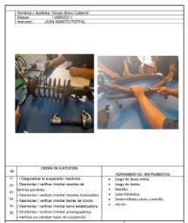
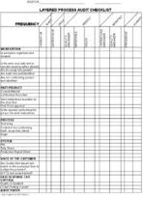
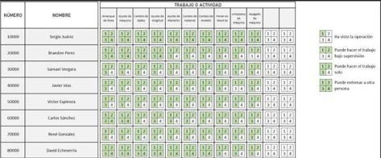
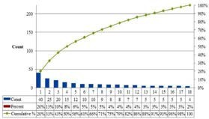
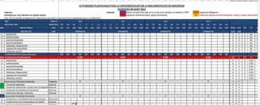
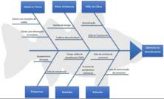
Quality Standars
Work Instruction
Skills Matrix (ILU)
LPA Check List
Record of Defects.
Pareto of Defects.
Problem Analisys.

Slide 11





Our Capability
Recruitment
Training
Continuous training of Quality Aspects.
Personal Management
Located at main office in SLP, for all customer sites.
HQ Office
Head Count
Located at San Luis Potosi.
75 HC at SLP.
120 HC Operation Mex.
15 Administrative Staff

Slide 12










Business references
North American Lighting Mexico
Nidec Corporation
TAXAN México
Daikin México
Continental Corporation en México
Plastics Technology de México
Plastic Omnium
Integrity Tool and Mold de México
Asiaway Automotive Components
Arcosa Industries de México

Slide 13


Legal Requirements
Our company is established in accordance with the regulations of the Mexican Government (STPS, IMSS, SATand REPSE).
Montlhy update according:
Opinión de Cumplimento (SAT)
Opinión de Cumplimento (INFONAVIT)
Opinión de Cumplimento (IMSS)

Slide 14



Muchas gracias.
Stamp Quality
Uriel Valdivia Contreras
+52 (444)4193741
Stampquality.servicios@hotmail.com Av. Malibú #571, Fraccionamiento Santa Barbara, Villa de Pozos, C.P. 78397 San Luis Potosí, SLP.

